Slide 1

Web Development Design
Kiva Loor

Slide 2
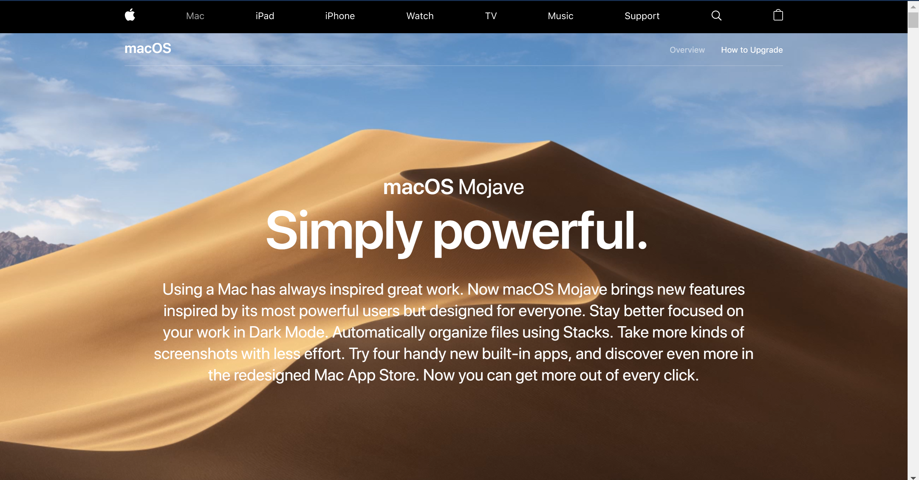
Apple
Flow
Minimalistic
Interactivity
Visuals
Images
Videos
https://www.apple.com/macos/mojave/

Slide 3

Travis Scott
Video background
Interactive head
Easy to navigate
https://travisscott.com/

Slide 4
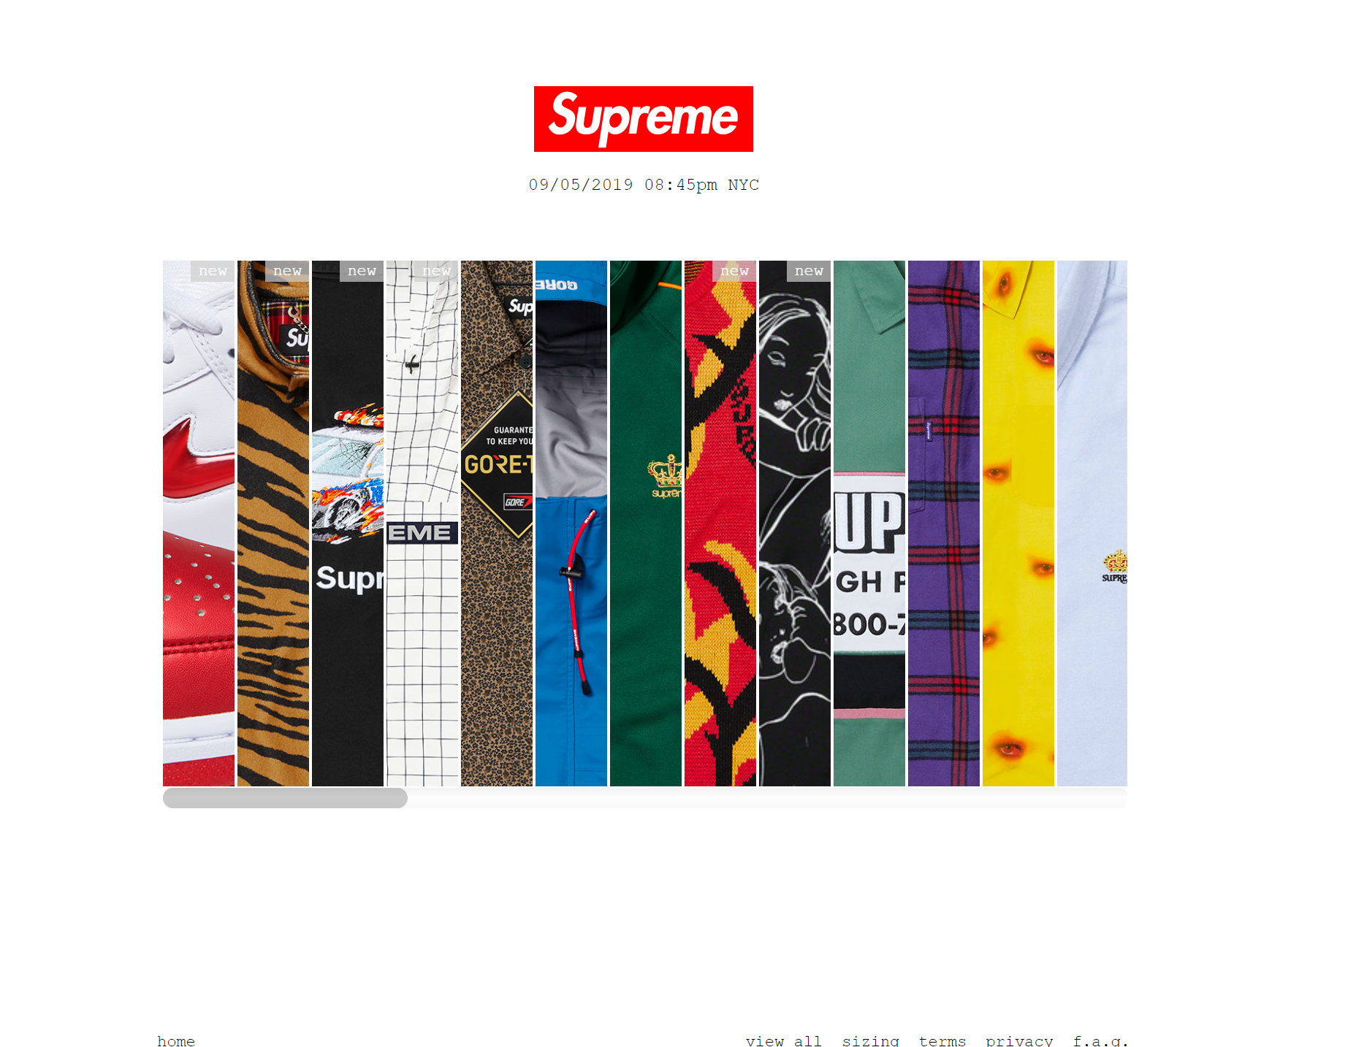
Supreme
Image tiling
Simple
Directed focus
https://www.supremenewyork.com/index

Slide 5
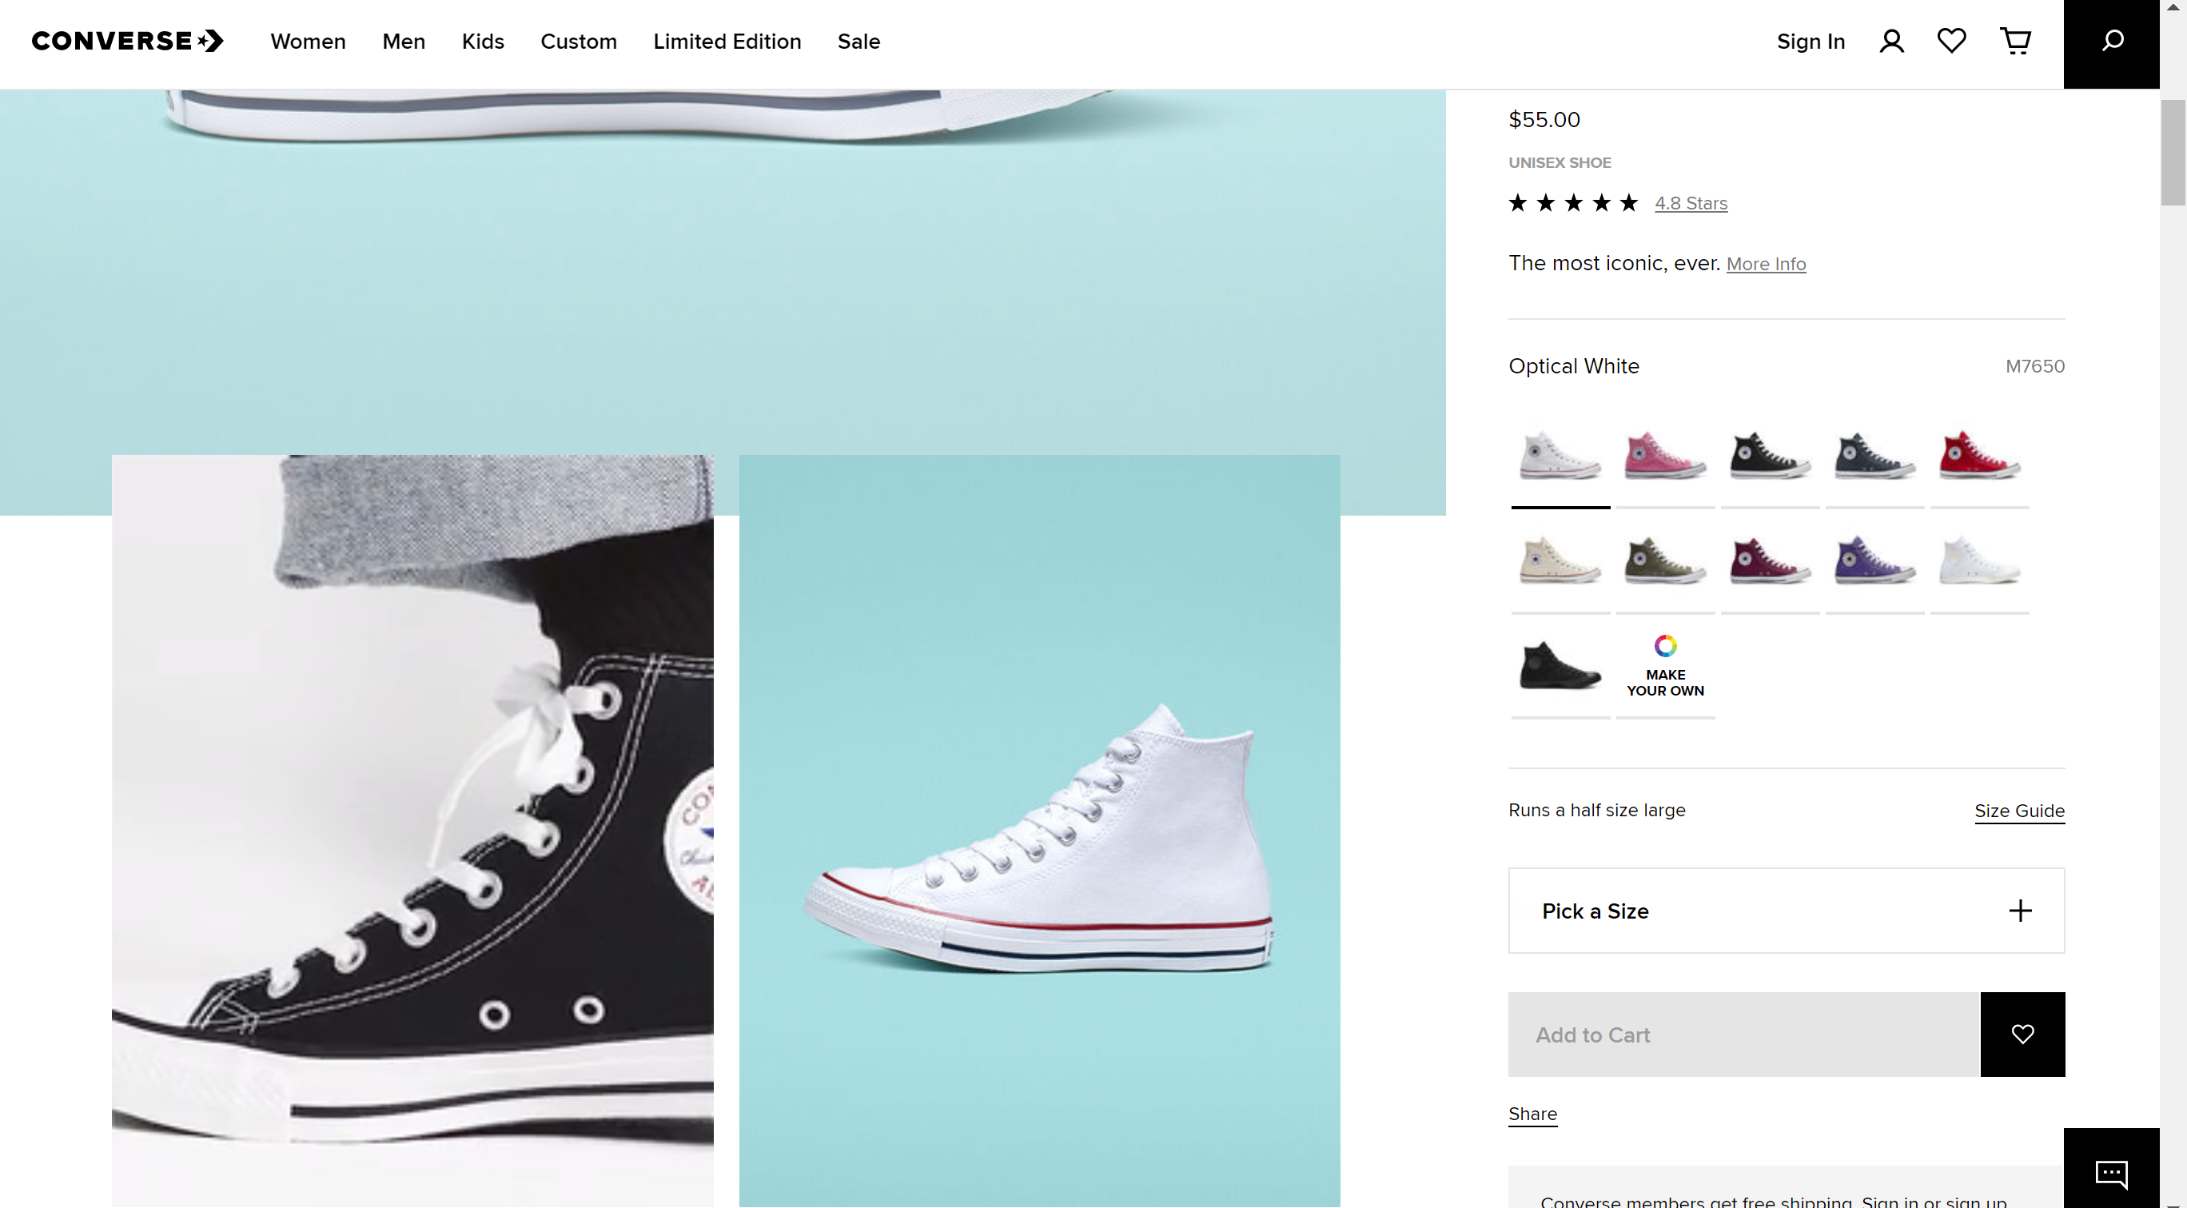
Converse
Media implementation
Collages, collage overlay
Styling
https://www.converse.com/

